Slide 1
Analysis in Classical MD
Janani Sampath

Slide 2
Spatiotemporal Analysis
Allows us to study persistence of patterns over time
Structure – property relationships
Non Equilibrium Simulations
Structure:
VMD snapshots
Radial distribution function
Structure factor
Cluster analysis
Dynamics:
Mean Squared Displacement
Autocorrelation functions
Velocity
End to end
Bond
Stress-Stress

Slide 3
Radial distribution function
Also known as g(r), pair correlation function
Given that a particle of type i is at the origin, g_{ij}(r) gives the probability of a type j particle existing at a distance r, relative to the probability in the bulk
For equilibrium simulations, average over many snapshots to get accurate data
Averaging two timesteps close together in time gives little benefit (both configurations will be similar), but it takes time
Averaging two timesteps that are far enough apart in time that they are uncorrelated reduces noise

Slide 4
Radial distribution function – Calculation
Pick a value of dr
Loop over all values of r that you care about:
Consider each particle you have in turn. Count all particles that are a distance between r and r + dr away from the particle you're considering. You can think of this as all particles in a spherical shell surrounding the reference particle. The shell has a thickness dr.
Divide your total count by N, the number of reference particles you considered -- probably the total number of particles in your data.
Divide this number by 4 pi r^2 dr, the volume of the spherical shell (the surface area 4 pi r^2, multiplied by the small thickness dr). This accounts for the fact that as r gets larger, for trivial reasons you find more particles with the given separation.
Divide this by the particle number density. This ensures that g(r)=1 for data with no structure. In other words, if you just had an arbitrarily placed spherical shell of inner radius r and outer radius r+dr, you'd expect to find about rho * V particles inside, where rho is the number density and V is the volume of that shell.

Slide 5
Radial distribution function – Examples

Slide 6
Structure Factor
Based on constructive/destructive interference, if you shine X-rays of a wavelength similar to your sample’s density fluctuations, and measure the intensity of scattered light as a function of angle (related to wavevector k) you will see scattering peaks related to those length scales.
After removing other features such as due to the experimental setup and the shape of the particles that are scattering, the remaining part of the scattering S(k) comes from the particle-particle structure/ordering.

Slide 7
Fluctuation Phenomena
In the early 1900s, scientists were beginning to understand the statistical consequences of everything being made of atoms
Big leap came in understanding fluctuations through work of Einstein, Smoluchowski, and Langevin
Understanding Brownian motion (pollen grains bouncing around randomly in the microscope, as seen in 1827 by Robert Brown)
There is a drag force on particles moving through liquid, proportional to velocity (and viscosity, size; Stokes’ law)
Equipartition tells us about the average velocity of nearby smaller particles (of water in Brown’s case) at a given temperature
assume many collisions with small particles lead to a random fluctuating force on the large particle, force is 0 on average with a Gaussian distribution
can calculate the size of the fluctuations in this force
Based on this can calculate diffusion constant
MSD
Reference for these notes (and typeset equations) from “Fluctuation-Dissipation: Response Theory in Statistical Physics”, Marconi et al, arXiv:0803.0719v1

Slide 8
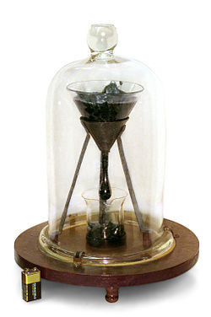
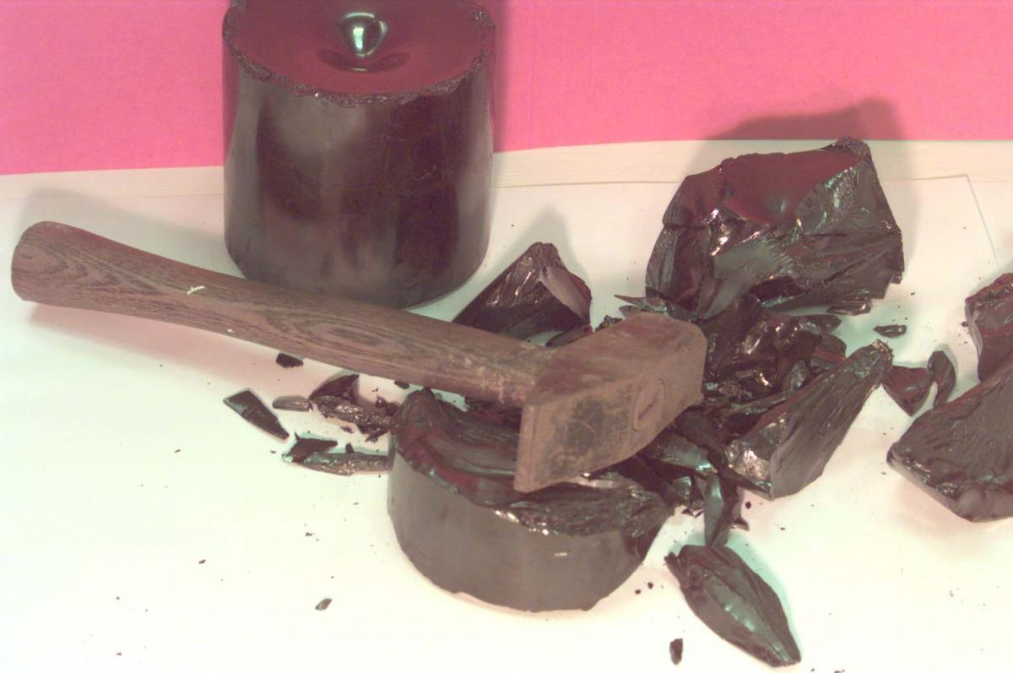
Timescales are important
Example: The Pitch Drop Experiment
9 drops have fallen in 86 years
http://smp.uq.edu.au/content/pitch-drop-experiment
Viscosity is 10¹¹ times that of water
Pitch acts like a brittle solid at short timescales
But like a liquid at long ones

Slide 9
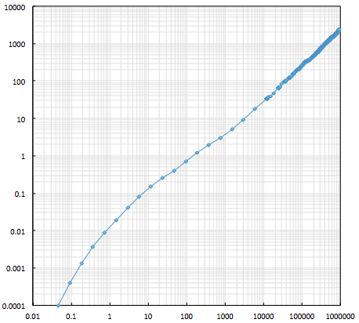
Mean Squared Displacement
MSD= average over all particles: (x(t)-x(0))^2
Time t is relative to time 0; for better statistics, average over many starting times
Time blocks can overlap, but then each data point won’t be “independent”
Very short times: ballistic motion (does not bump into anything); MSD proportional to velocity squared
Long times: Fikian diffusion

Slide 10
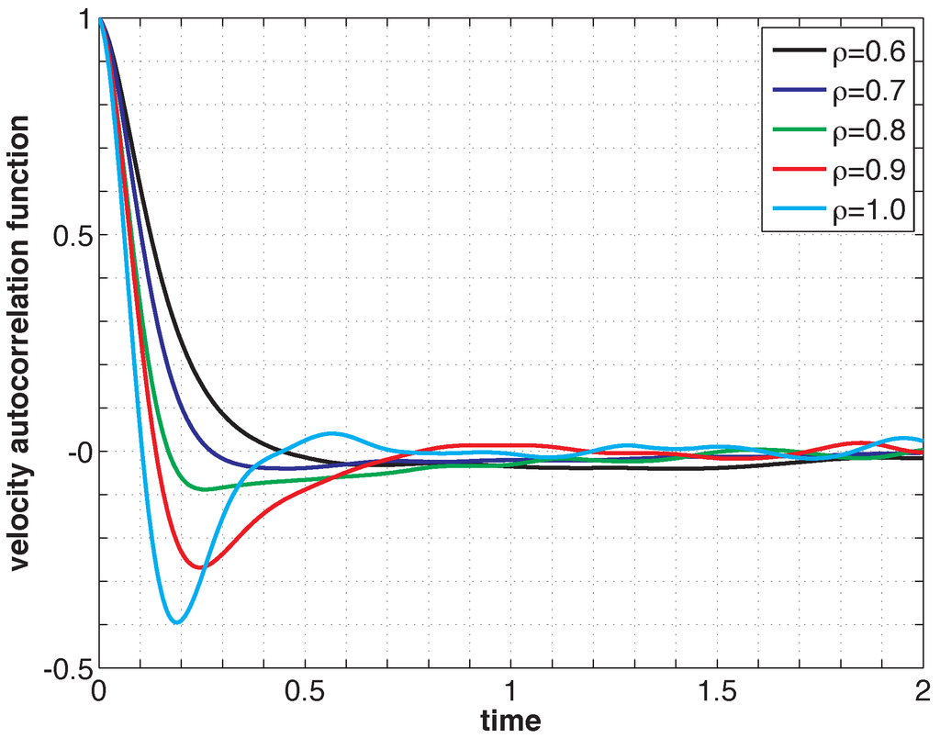
Autocorrelation Function
<> Indicates average over all particles and initial times t₀
<v²>=3k_{B}T/m
High density/low temperature: caging
Example:
Soft sphere fluid
Beads are confined in local “cage” and bounce nearly straight back, causing the correlation to go negative
Increasing density
Low density/high temperature: diffusion
Beads are able to move past each other, so beads tend to keep going in the same direction, making the VACF positive

